Slide 1
Coronavirus (COVID-19)
Global Pandemic hotspot tracker

Slide 2
Concepts
Create a simple app/site to visually display COVID-19 case numbers around the world
Motivation – during pandemic time it is important to track and have an integrated platform show the results in easy and simple format;
User – People with general interest in knowing which countries have the highest rates of infection today, people may consider travelling to another country, or in my own country and wish to know up-to-date global statistics;
Integrated interface contain a world map API with the statistics API to display which countries have the highest case loads;
Display guidance on where to seek help, how to get Emergency help in each country plus some simple guides on hygiene procedures for COVID-19 and symptoms.

Slide 3
Process
Technology and Resources Used
GitHub
Trello Board
Breakdown of Tasks
Lihour
HTML Body and Trello Board
Yvette
Resources and Hygiene Pages
Challenges
Interactive different people with different skills
1st project
Github Branch merging/approval
Visual Studio Code
RapidAPI, Chart.JS
GoogleAPI
Lucas
Github Project Hosting, APIs and JS
Louise
APIs and JS
Materialize

Slide 4
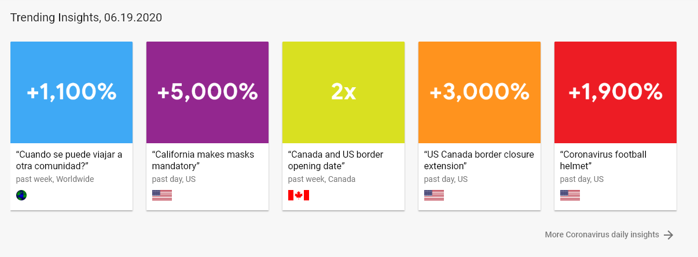
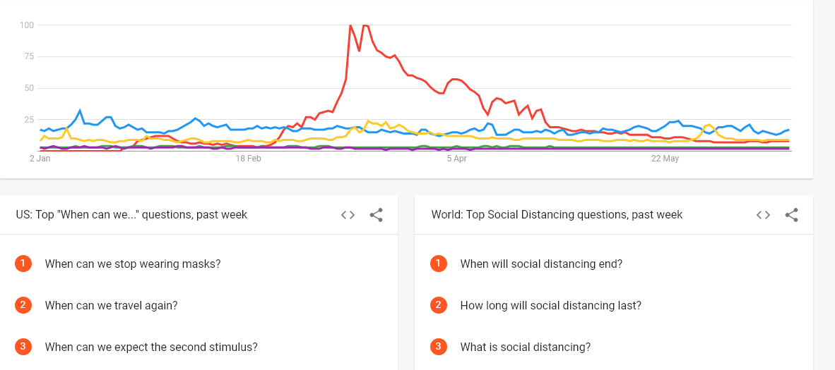
Directions for Future Development
Coronavirus remains topical
Data continues to be sought after for news, interest and travel purposes
As restrictions ease – people use a variety of resources to inform travel
Google Trends

Slide 5
Demo

Slide 6
Links
Github Project
Github Webpage
https://github.com/ldipaola/bootcamp-project-1
https://ldipaola.github.io/bootcamp-project-1/

